Slide 1

NATURAL LANGUAGE PROCESSING
Presented by:
jv’n Swati Gupta (jv-u/16/9122)
Jv’n Pragya Nimbark (jv-u/16/9115)
Faculty of Computer Science and Electronics in Engineering

Slide 2
CONTENTS
Introduction
Natural Language Processing
Natural Language Understanding
Levels in NLP
Natural Language Generation
Steps In NLP
Application Of NLP
Challenges Of NLP
Conclusion

Slide 3
NATURAL LANGUAGE PROCESSING
Natural language processing (NLP) is a subfield of computer science information engineering, and artificial intelligence concerned with the interactions between computers and human (natural) languages.
NLP is a way for computers to analyze, understand, and derive meaning from human language in a smart and useful way.

Slide 4
NATURAL LANGUAGE GENERATION
NLG frameworks react to human languages with canny, clear reactions that are valuable and bode well. Through the most recent profound learning calculations, NLG frameworks can understand questions and issues and react with canny answers. Basically, NLG creates content from information that has been prepared through NLP and NLU.

Slide 5
NATURAL LANGUAGE UNDERSTANDING
This is the initial phase in handling; understanding what the human is stating, what they are teaching the machine to do or the inquiry they are inquiring.
People are ordinarily ready to see each other when they talk a similar language

Slide 6
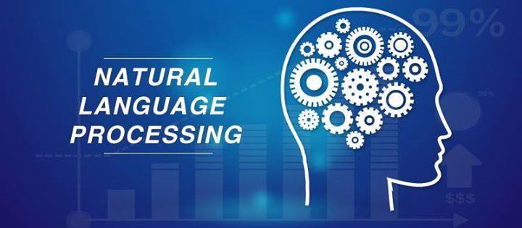


Slide 7
Advantages
Saves Time
It is used to translate many form of language
It is used in telephones
Provides high quality information
Automatic synthesis and summarization
Search more effective

Slide 8
Steps in NLP
Lexical Analysis
It involves identifying and analyzing the structure of words. Lexicon of a language means the collection of words and phrases in a language. Lexical analysis is dividing the whole chunk of txt into paragraphs, sentences, and words.
Syntactic Analysis(Parsing)
It involves analysis of words in the sentence for grammar and arranging words in a manner that shows the relationship among the words.

Slide 9
Semantic Analysis
It draws the exact meaning or the dictionary meaning from the text.
The text is checked for meaningfulness
Discourse Integration
The meaning of any sentence depends upon the meaning of the
sentence just before it.
Pragmatic Analysis
During this, what was said is re-interpreted on what it actually meant.
It involves deriving those aspects of language which require real world
knowledge.

Slide 10
Application
Machine Translation
Automatic Summarization
Sentiment Analysis
Text Classification
Question Answering
Customer Service
Market Intelligence

Slide 11
Challenges For NLP
Physical Limitations
No Unifying Ontology
No Unifying Semantic Repository
Current Information Retrieval System

Slide 12
Conclusion
Natural language processing is a field of software engineering and AI that centers principally around the communication among PCs and people. The absolute first NLP was planned in 1950.
Some genuine utilization of natural language processing in corporate Apple’s Siri and Microsoft Cortana. The future of NLP is bright.

